Slide 1
House Hawk
Home Security Application

Slide 2
Project Summary
HouseHawk is a home security application
Detects motion and captures images
Displays pictures on a mobile application
Mixture of hardware and software components
Hardware - Camera system
Software - Backend & Mobile Application

Slide 3

High Level Description
Camera system
Senses motion
Captures images
Server & database
Store information
Mobile application
View information

Slide 4
Camera System
Used to detect motion and capture images
Raspberry Pi
Scripts coded in Python
Connects to home internet
Modules:
Camera
PIR Motion Detector

Slide 5
Camera System
Three main scripts
Main.py
Backbone of camera system
Runs the program
Motion.py
Responsible for detecting motion
Camera.py
Responsible for handling image captures

Slide 6
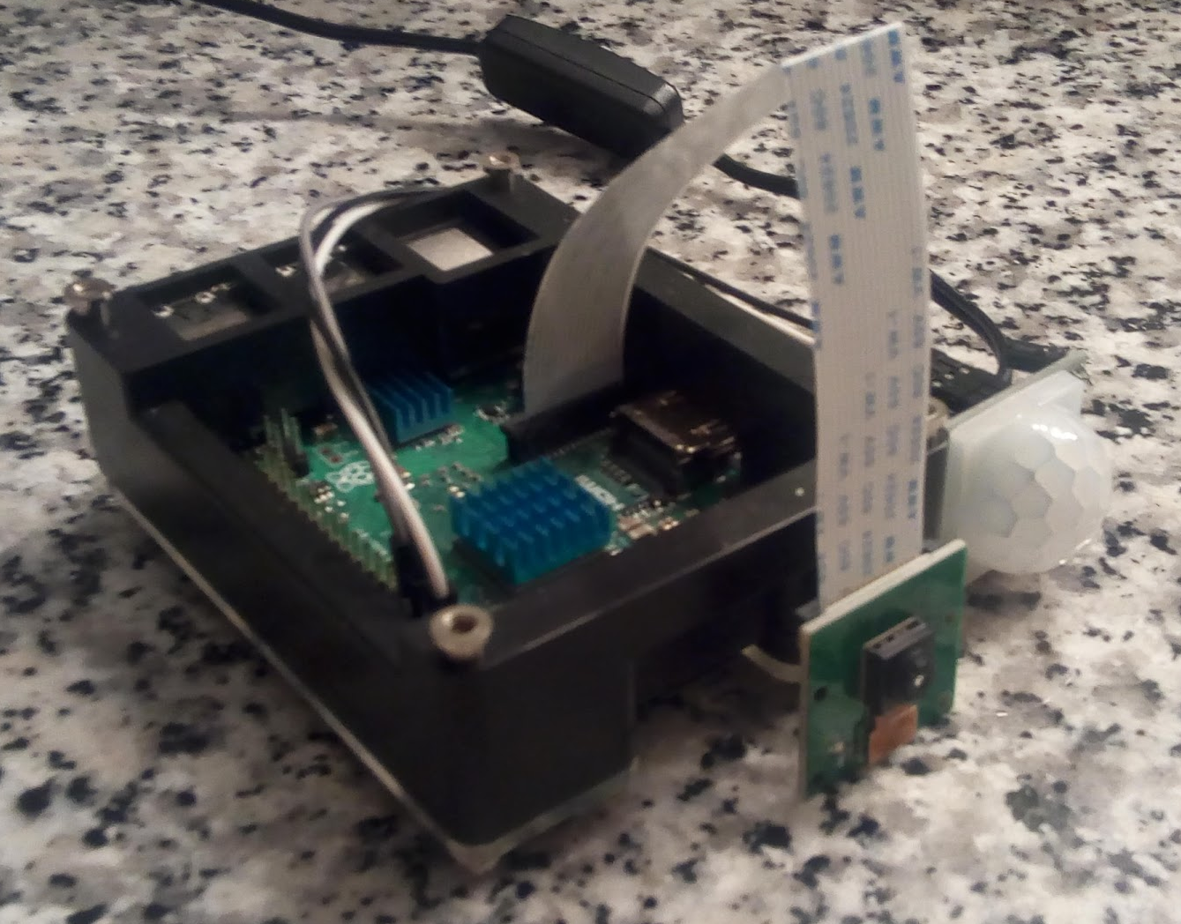
Camera System
Raspberry Pi
Motion Sensor
Camera

Slide 7
Server & Database
Server
Amazon AWS EC2 running Ubuntu instance
Used to host database and store images
Database
MySQL - eight tables
Used to handle storage of information
Stores a file path for each image on server

Slide 8
Mobile Application
Flutter
Developed using a plugin for Android Studio
Allows quick restarting of device during testing
Works on both Android and iOS devices
Receives push notifications for new pictures

Slide 9
Mobile App Screens
Total of eight screens:
Login
Create
Home
Account
Cameras
Exposures
Pictures
Recent

Slide 10
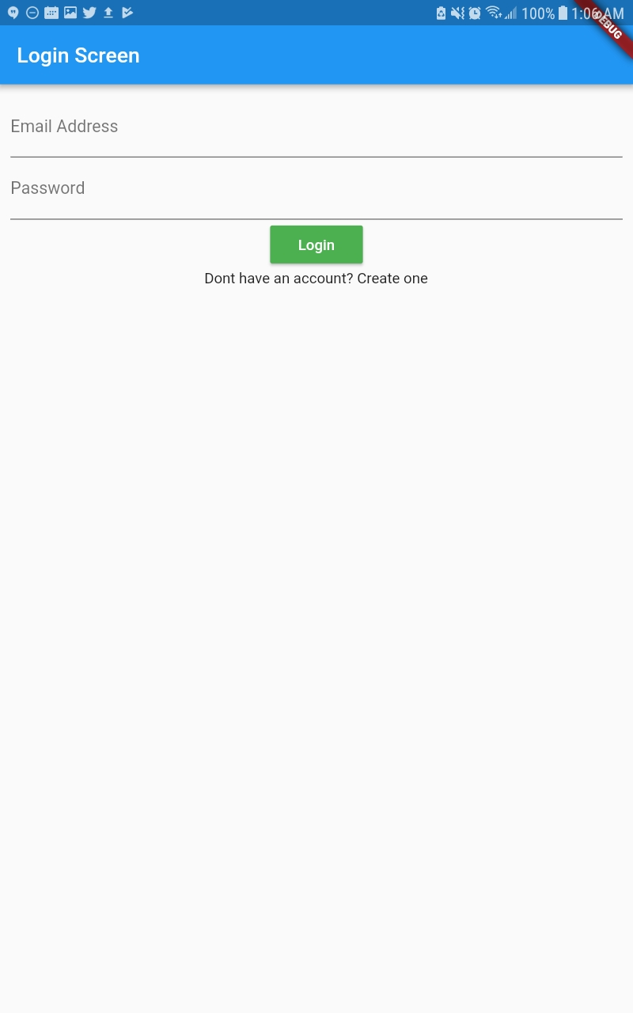
App Screens - Login
First screen when app is opened
Functionality:
Navigate to Create Account Screen
Sign into existing account

Slide 11
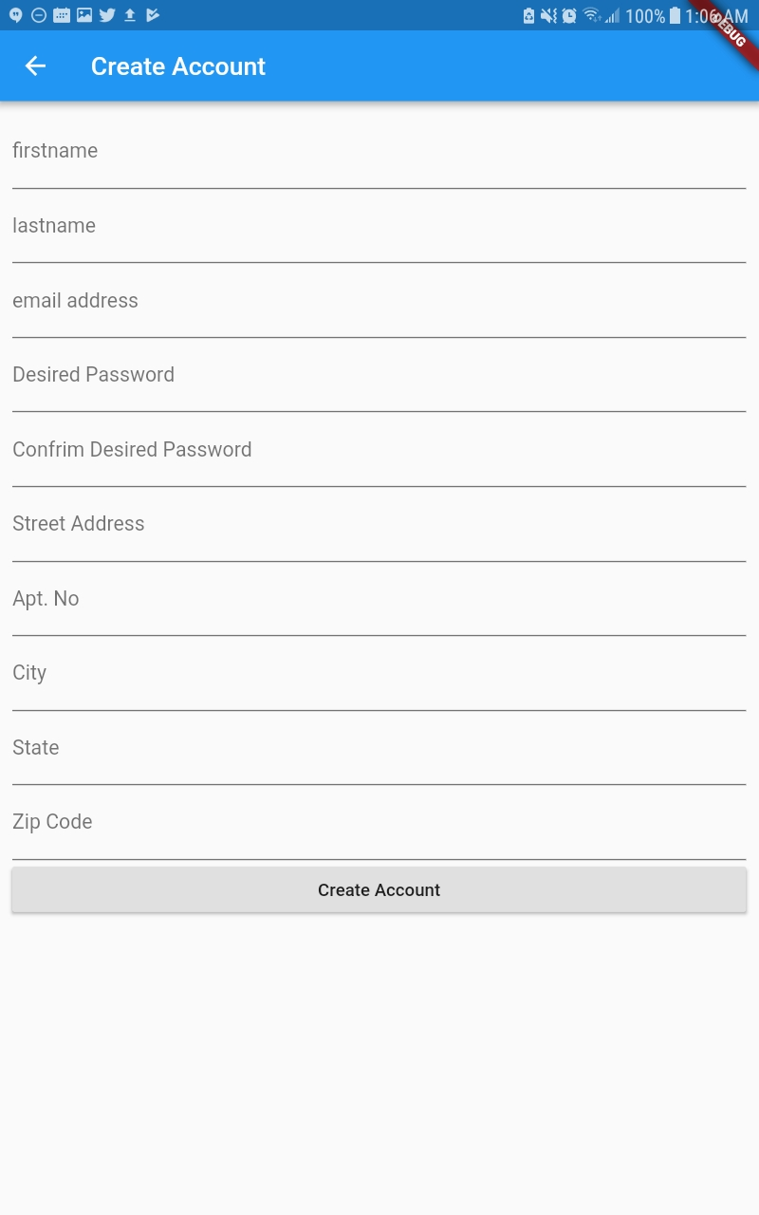
App Screens - Create
Allows user to create a new account
Required information:
Name
Password
Email
Home address

Slide 12
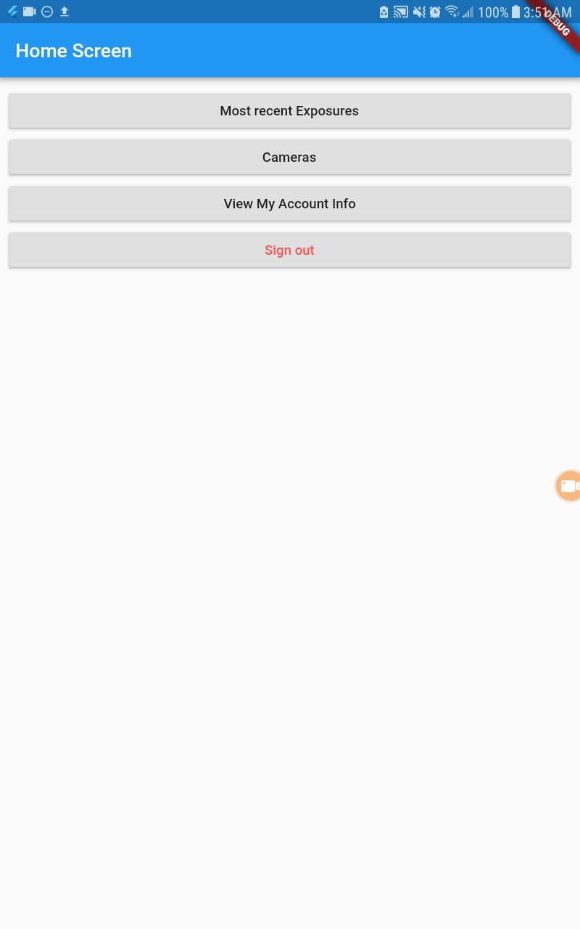
App Screens - Home
First screen seen after logging in
Acts as a hub for all user interaction
Functionality:
Update or view account info
View cameras
View most recent exposure

Slide 13
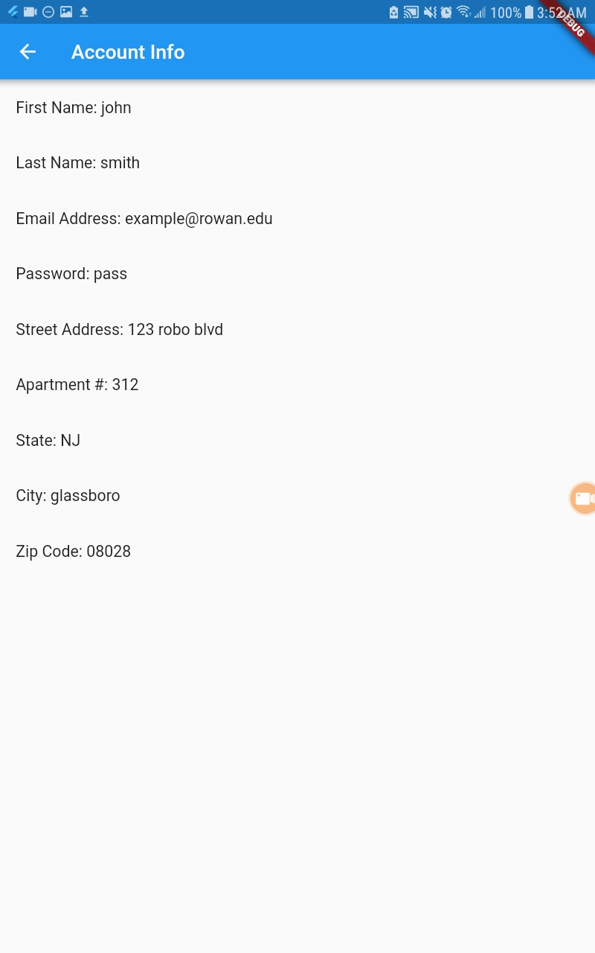
App Screens - Account
Allows user to view their personal information initially entered in the application upon account registration.

Slide 14
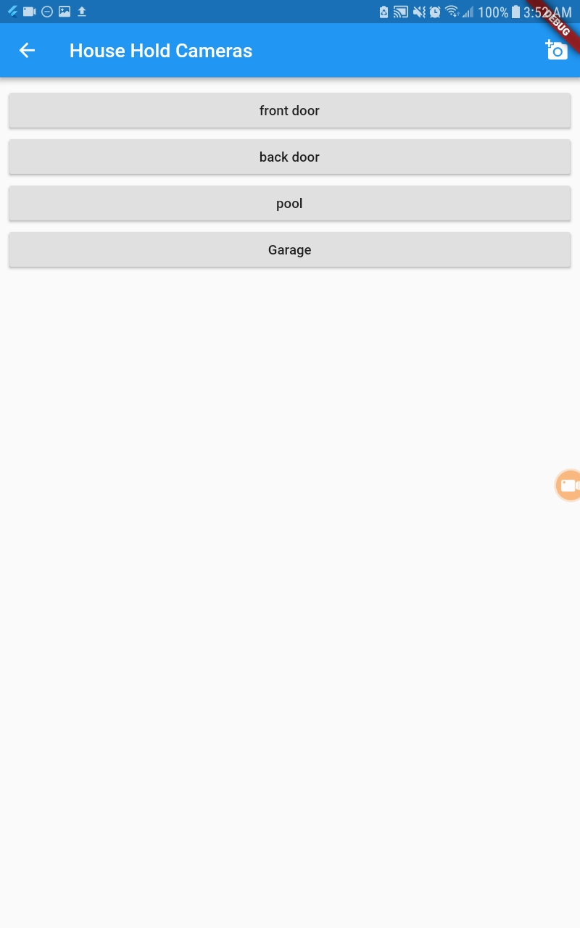
App Screens - Cameras
Allows user to add a camera
View all cameras per user
Functionality:
Click on add to add a new camera
Click on camera to view exposures

Slide 15
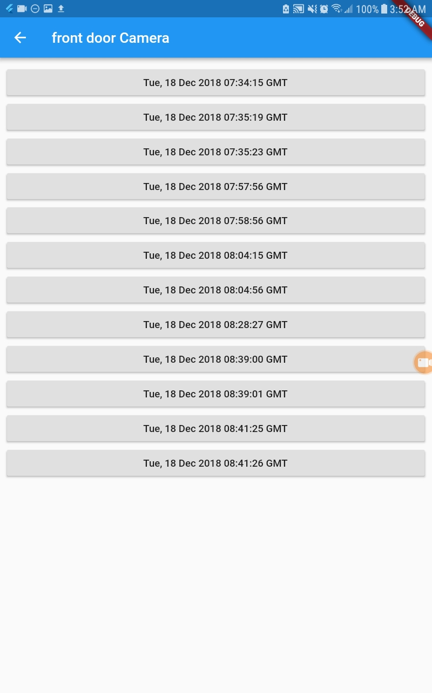
App Screens - Exposures
View all exposures per camera
Functionality:
Click on exposure to view pictures

Slide 16
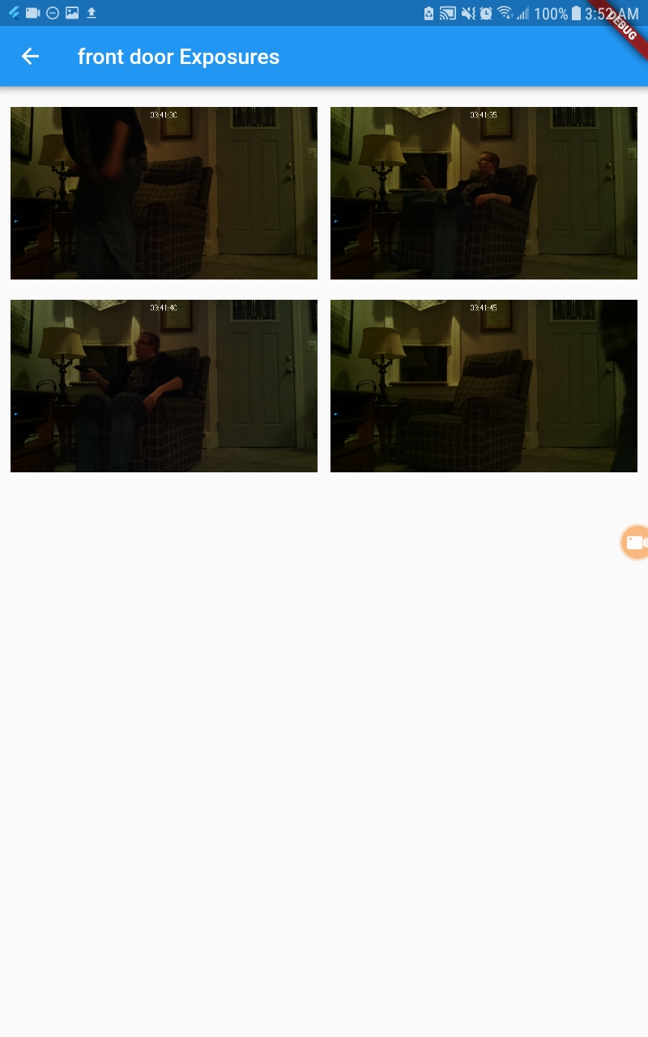
App Screens - Pictures
View all pictures per exposure
Functionality:
Click on picture to view it

Slide 17
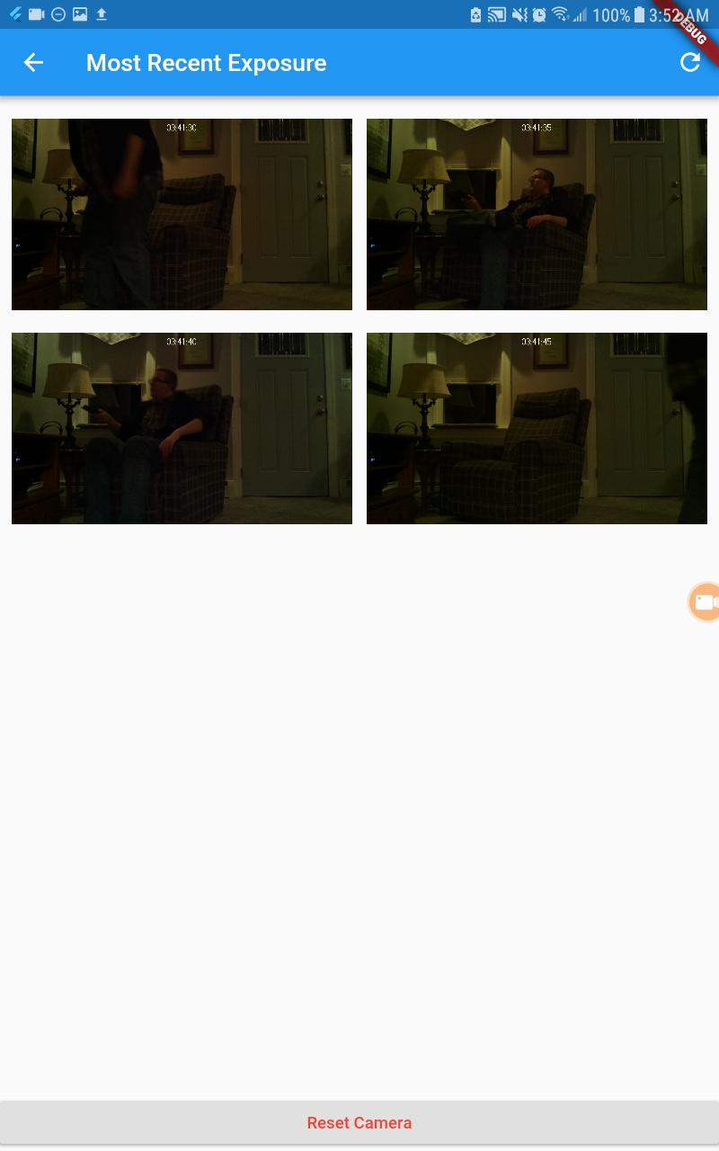
App Screens - Recent
Works exactly the same as pictures
Only populates with the most recent exposure
Functionality:
Click on picture to view it

Slide 18
Demonstration
Create account and login
Sign into account and view info
View cameras and exposures
Add new camera to account
Receive push notification

Slide 19
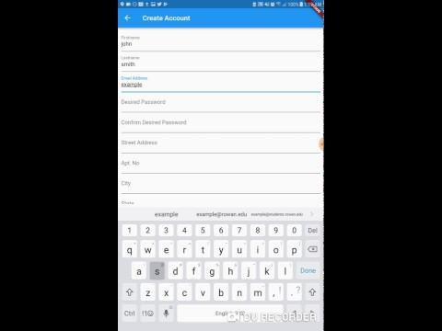
Creating an Account
Create a new user account
Login with that new user
Show their account information
Logout

Slide 20
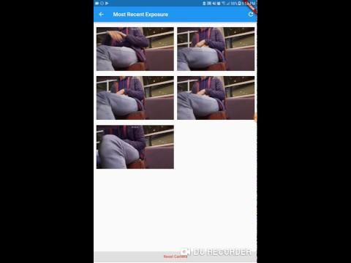
Demo Presentation - Sign into Existing Account
Signing in
Account Info
Cameras
Exposures
Pictures
Most Recent Pictures
Logging Out

Slide 21
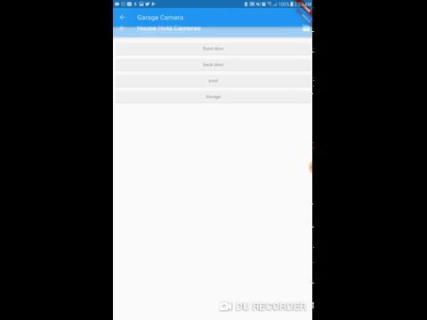
Demo Presentation - Add New Camera

Slide 22

Demo Presentation - Push Notifications
Receive a notification that a new pictures have been created
Click the notification
View the most recent pictures
Refresh the images
Reset the Pi

Slide 23
Conclusions
Home security application
Components:
Camera system
Database & server
Mobile application
Eight screens

Slide 24

Questions?

